Slide 1
Murach’s PHP and MySQL (4th Edition)
Chapter 21
How to create secure websites

Slide 2
Objectives
Applied
Use a secure connection and the Secure Sockets Layer (SSL) protocol for your web pages whenever that’s needed.
Use form-based authentication for your web pages whenever that’s needed.
Knowledge
Describe the use of the SSL protocol for getting a secure connection and providing for authentication, including the use of a digital secure certificate, SSL strength, and the $_SERVER array.
Distinguish between form-based authentication and basic authentication.
Describe how a secure connection protects sensitive data that’s sent from the browser to the server.

Slide 3
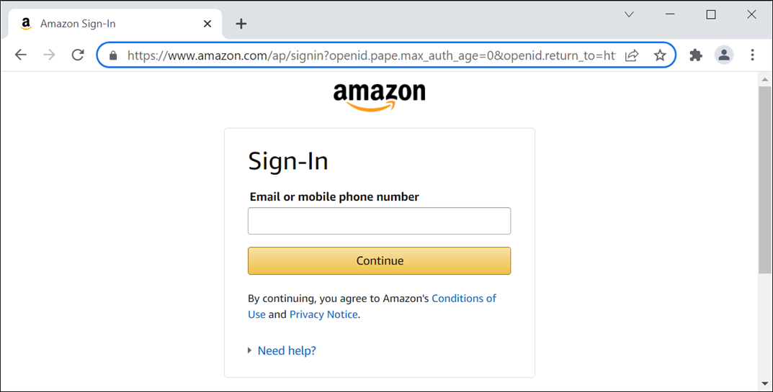
A request made with a secure connection

Slide 4
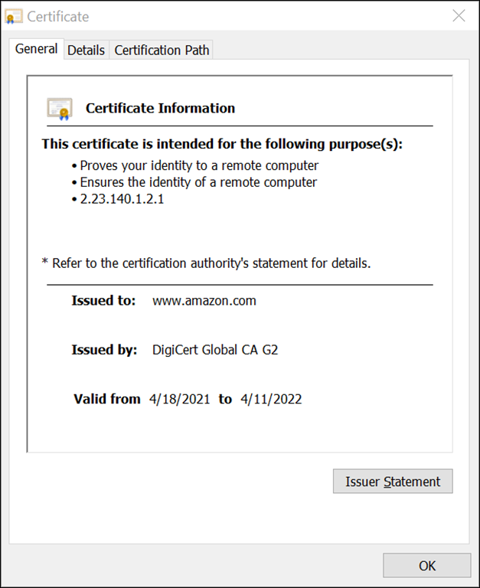
A digital secure certificate

Slide 5
Types of digital secure certificates
Server certificate
Client certificate

Slide 6
How authentication works
Authentication is the process of determining whether a server or client is who and what it claims to be.
When a browser makes an initial attempt to communicate with a server over a secure connection, the server authenticates itself by providing a digital secure certificate.
If the digital secure certificate is registered with the browser, the browser won’t display the certificate by default. However, the user still has the option to view the certificate.
In some rare cases, the server may request that a client authenticate itself by presenting its own digital secure certificate.

Slide 7
Authorities that issue digital secure certificates
www.identrust.com/manage/certificates
www.digicert.com
sectigostore.com/ssl-certificates
letsencrypt.org
www.godaddy.com/ssl
SSL strengths
40-bit
56-bit
128-bit
256-bit

Slide 8
Key terms related to secure connections
Transport Layer Security (TLS)
Secure Sockets Layer (SSL)
secure connection
encryption
authentication
digital secure certificate
certification authority (CA)
registration authority (RA)
SSL strength

Slide 9
URLs for secure connections on a local system
Test if secure connections are configured correctly
https://localhost/
Request a secure connection
https://localhost/book_apps/ch21_ssl/
Return to a regular connection
http://localhost/book_apps/ch21_ssl/

Slide 10
URLs for secure connections over the internet
Request a secure connection
https://www.murach.com/
Return to a regular connection
http://www.murach.com/

Slide 11
The $_SERVER array
Index | Description
HTTPS | Returns a non-empty value if the current request is using HTTPS.
HTTP_HOST | Returns the host for the current request.
REQUEST_URI | Returns the URI (Uniform Resource Identifier) for the current request.

Slide 12
A utility file that redirects to a secure connection
<?php
// make sure the page uses a secure connection
$https = filter_input(INPUT_SERVER, 'HTTPS');
if (!$https) {
$host = filter_input(INPUT_SERVER, 'HTTP_HOST');
$uri = filter_input(INPUT_SERVER, 'REQUEST_URI');
$url = 'https://' . $host . $uri;
header("Location: " . $url);
exit();
}
?>

Slide 13
Form-based authentication
Allows the developer to code a login form that gets the username and password.
Allows the developer to only request the username and password once per session.
By default, it doesn’t encrypt the username and password before sending them to the server.
Basic authentication
Causes the browser to display a dialog box that gets the username and password.
Requires the browser to send the username and password for every protected page.
By default, it doesn’t encrypt the username and password before sending them to the server.

Slide 14
Two functions for working with passwords
Function | Description
password_hash($password, $algorithm) | Creates a new hash of the password using a strong salt and a strong one-way encryption algorithm.
password_verify($password, $hash) | Returns TRUE if the specified password matches the specified hash. Otherwise, returns FALSE.
Two constants for setting the algorithm
Constant | Description
PASSWORD_BCRYPT | Uses the bcrypt algorithm to create a hash that’s 60 characters long.
PASSWORD_DEFAULT | Uses the default algorithm of the password_hash() function. With PHP 5.5 and later, the default algorithm is bcrypt.

Slide 15
Code that hashes a password using the default algorithm
$password = 's3sam3';
$hash = password_hash($password, PASSWORD_DEFAULT);
// '$2y$10$xIqN2cVy8HVuKNKUwxFQR.xRP9oRj.FF8r52spVc.XCaEFy7iLHmu'
Code that verifies whether a password is valid
$valid_password = password_verify('s3sam3',
'$2y$10$xIqN2cVy8HVuKNKUwxFQR.xRP9oRj.FF8r52spVc.XCaEFy7iLHmu');
if ($valid_password) {
echo "Password is valid.<br>";
}

Slide 16
A script that creates a table for storing usernames and passwords
CREATE TABLE administrators (
adminID INT NOT NULL AUTO_INCREMENT,
emailAddress VARCHAR(255) NOT NULL,
password VARCHAR(255) NOT NULL,
firstName VARCHAR(60),
lastName VARCHAR(60),
PRIMARY KEY (adminID)
);
INSERT INTO administrators (adminID, emailAddress, password) VALUES
(1, 'admin@myguitarshop.com',
'$2y$10$xIqN2cVy8HVuKNKUwxFQR.xRP9oRj.FF8r52spVc.XCaEFy7iLHmu'),
(2, 'joel@murach.com',
'$2y$10$.imVkbsvI2XTC13bMONdUOllyhddj/IhYZBGU87nqZ1j8ebXPezre'),
(3, 'mike@murach.com',
'$2y$10$21KIM2059gSrnAQWV.5Ciufzo9sNqONmmzIhE8qvd/IDaeQvHG1Eq');

Slide 17
The admin_db.php file (part 1)
<?php
function add_admin($email, $password) {
$db = Database::getDB();
$hash = password_hash($password, PASSWORD_DEFAULT);
$query = 'INSERT INTO administrators (emailAddress,
password)
VALUES (:email, :password)';
$statement = $db->prepare($query);
$statement->bindValue(':email', $email);
$statement->bindValue(':password', $hash);
$statement->execute();
$statement->closeCursor();
}

Slide 18
The admin_db.php file (part 2)
function is_valid_admin_login($email, $password) {
$db = Database::getDB();
$query = 'SELECT password FROM administrators
WHERE emailAddress = :email';
$statement = $db->prepare($query);
$statement->bindValue(':email', $email);
$statement->execute();
$row = $statement->fetch();
$statement->closeCursor();
$hash = $row['password'];
return password_verify($password, $hash);
}
?>

Slide 19
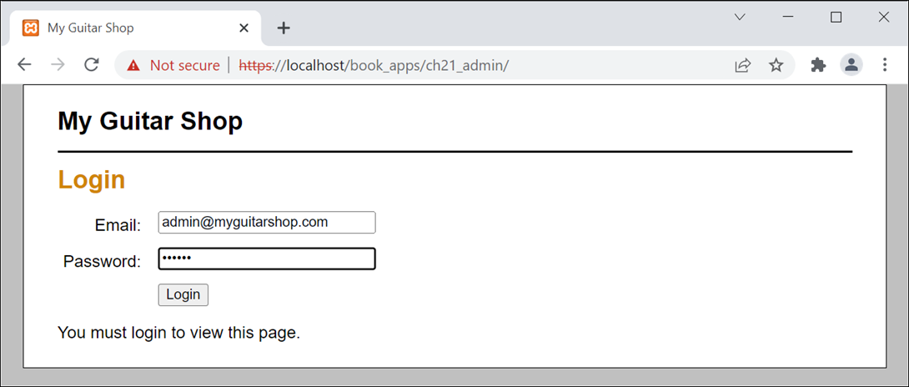
A login form

Slide 20
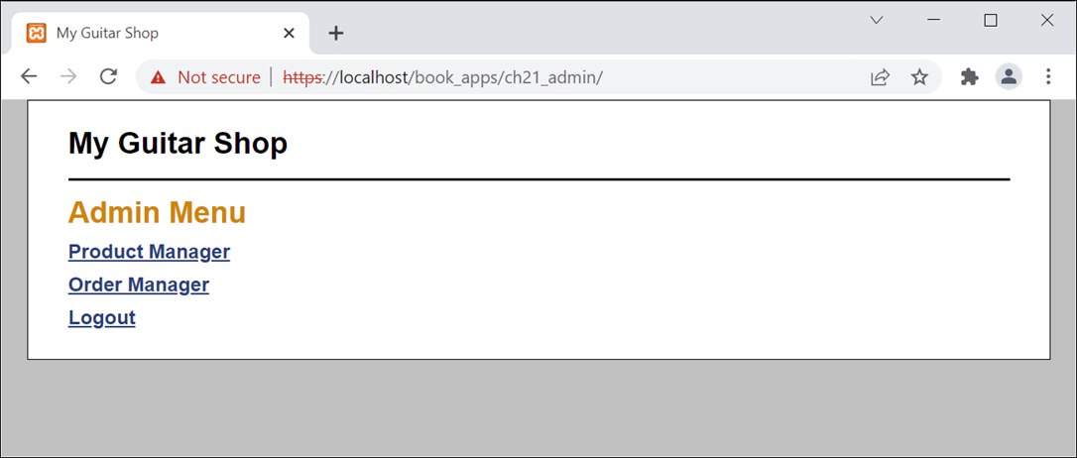
A protected page

Slide 21
The controller for the protected pages (part 1)
<?php
// Start session management and include necessary functions
session_start();
require_once('model/database.php');
require_once('model/admin_db.php');
// Get the action to perform
$action = filter_input(INPUT_POST, 'action');
if ($action == NULL) {
$action = filter_input(INPUT_GET, 'action');
if ($action == NULL) {
$action = 'show_admin_menu';
}
}
// If the user isn't logged in, force the user to login
if (!isset($_SESSION['is_valid_admin'])) {
$action = 'login';
}

Slide 22
The controller for the protected pages (part 2)
// Perform the specified action
switch($action) {
case 'login':
$email = filter_input(INPUT_POST, 'email');
$password = filter_input(INPUT_POST, 'password');
if (is_valid_admin_login($email, $password)) {
$_SESSION['is_valid_admin'] = true;
// redirect logged in user to default page
header("Location: .");
} else {
$login_message =
'You must login to view this page.';
include('view/login.php');
}
break;
case 'show_admin_menu':
include('view/admin_menu.php');
break;
case 'show_product_manager':
include('view/product_manager.php');
break;

Slide 23
The controller for the protected pages (part 3)
case 'show_order_manager':
include('view/order_manager.php');
break;
case 'logout':
$_SESSION = []; // Clear all session data
session_destroy(); // Clean up the session ID
$login_message = 'You have been logged out.';
include('view/login.php');
break;
}
?>

Slide 24
A utility file that forces a valid admin user
<?php
// make sure user is a valid administrator
if (!isset($_SESSION['is_valid_admin'])) {
header("Location: ." );
}
?>
Code at the top of the login page
<?php
// require a secure connection
require_once('util/secure_conn.php');
?>
Code at the top of the other protected pages
<?php
// require a secure connection
require_once('util/secure_conn.php');
// require a valid admin user
require_once('util/valid_admin.php');
?>

